Slide 1
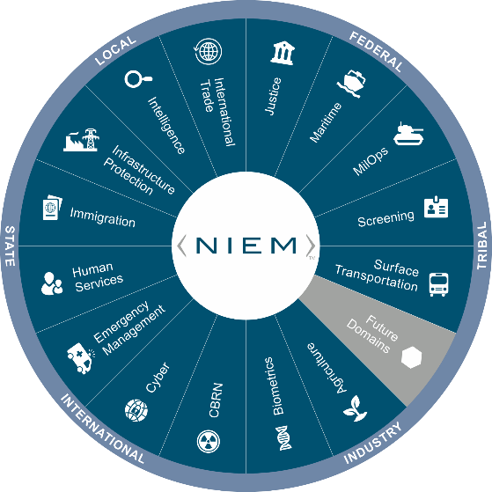
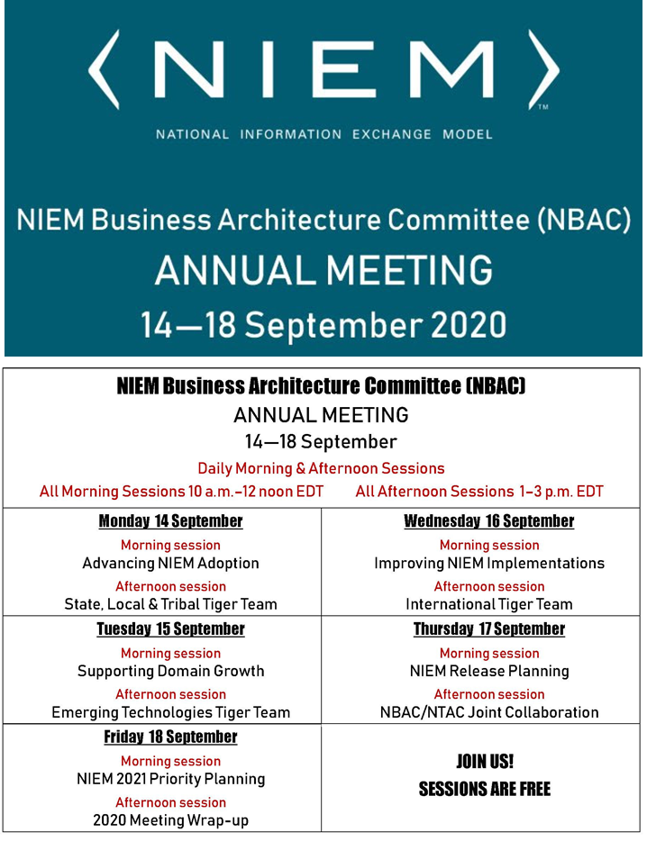

Virtual Annual Meeting (NBAC)
16 September 2020 → 1-3PM
International Tiger Team
Thomas Krul
NBAC Co-Chair
Enterprise Architect,
Public Safety Canada
Thomas.krul@Canada.ca

Slide 2
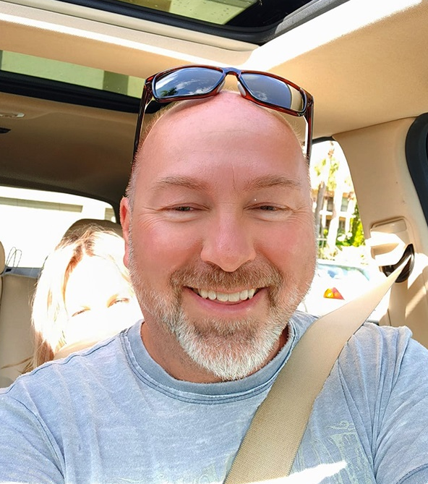

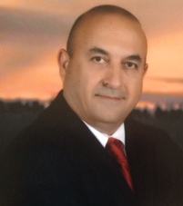




Housekeeping
HOUSEKEEPING:
MUTE your mic when you’re not talking
Identify yourself before you start to speak
Speak clearly
Disable “call waiting” feature (the clicking noise can be heard by all)
Please note: All 2020 sessions are audio recorded for NIEM training & communications purposes
QUESTIONS & ANSWERS ARE ENCOURAGED!
To signal you want to contribute without interrupting the speaker
Enter comments via CHAT window at any time
To signal a question or respond to a question
Click on ‘Raise your hand’ button on meeting toolbar
(Lower hand after you’ve talked by clicking hand button again)
All session briefings are available on NIEM’s GitHub for download as they occur
Speakers
Primary Facilitator
Thomas Krul
Support Facilitator
Kamran Atri
Guest Speaker
Poewen Lau
Department of National Defense
https://github.com/NIEM/NIEM-Annual-Meetings/tree/master/2020
2

Slide 3

Session Agenda
Introduction
Guest Speaker: Poewan Lau
Background
Defining Internationalization
Data Model Management
Translation efforts, outreach
Tiger Team and Canada updates
3

Slide 4
Introducing Guest Speaker
Poewan Lau
Department of National Defense
Enabling System-to-System (S2S) Information Sharing

Slide 5
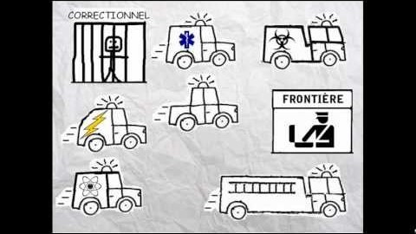
A short video

Slide 6
Background
The NBAC International Tiger Team launched in late 2016 with an overarching goal of expanding the utility of NIEM Program to a larger global audience.
Design concepts, governance, training, and impacts on model architecture and engineering
6

Slide 7
Defining internationalization
"Going Global" - wrap our arms around the different moving parts
5 eyes for immigration - passport offices
Long handshake between Canada and UK
Japan using it for Olympics
NIEM and NATO NCDF
INTERPOL
Organizing efforts around how Internationalizing NIEM looks
7

Slide 8
Data model management
The earliest and still central priority of the tiger team was the review and alignment of both Core and Domain data models with a more International Program focus. This will continue with the identification and review of existing, new or emerging data sets, exchange models, IEPDs or other attribute sources that may yield new, unique attributes that support international exchange.
8

Slide 9
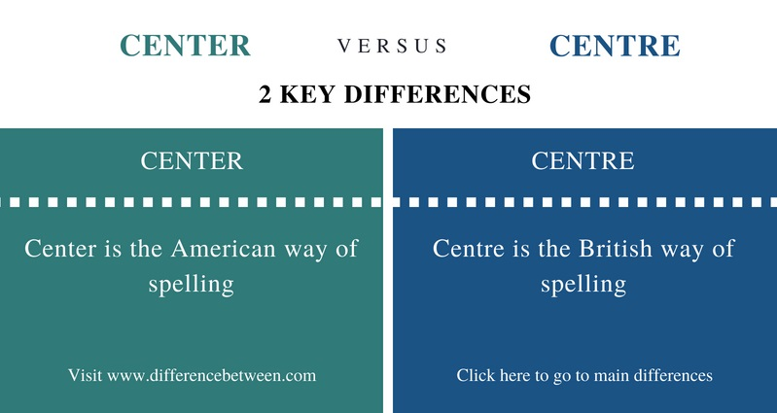
Data model management
Refinements to US-centric terms/definitions in Core
Not all issues are related to language!
Each new release has inputs to both core and domain models
XML Lang 5.0 schema update
Webb Roberts will present
9

Slide 10
Localization
Localization - NIEM data model
Local terminology and jargon
Local terms for component names and definitions
Language localization on tools
Ongoing maintenance
10

Slide 11
localization
Governance body for Core
Governance body for Domains
Governance body for Languages?
11

Slide 12
Outreach
Using English as “go-forward” position
Countries are responsible for translation
NIEM support these bodies
Translations for some components, web content, training
12

Slide 13
Tiger team activities
Biometrics and Emergency Management domains being extracted via UML modeling tool, translated, evaluated by subject matter experts
Processes used by Canadian NIEM-enabled services being documented for best practice(s)
Ongoing discussions regarding use cases and how to best use internationalized versions of NIEM
Bringing forward issues
13

Slide 14
Canadian adoption
Many Canadian departments have adopted NIEM in other domains, including CSC, CBSA, RCMP, ESDC, etc.
Employment and Social Development Canada extensively using NIEM
Other Departments are using or are considering using NIEM as well
The Enterprise Data Community of Practice approaches Interoperability from a technology standpoint (e.g., NIEM, Reference Data Standards, etc.)
Working with the Enterprise Data Community of Practice to make NIEM Government of Canada-wide (standardize use)
14

Slide 15
What you can do to help internationalization niem
We would like to know if there are any international groups that share (or could share) information within your domain.
Are you aware of any services provided by US Gov provide information in a language of choice other than English (or would like to)?
15

Slide 16


Slide 17
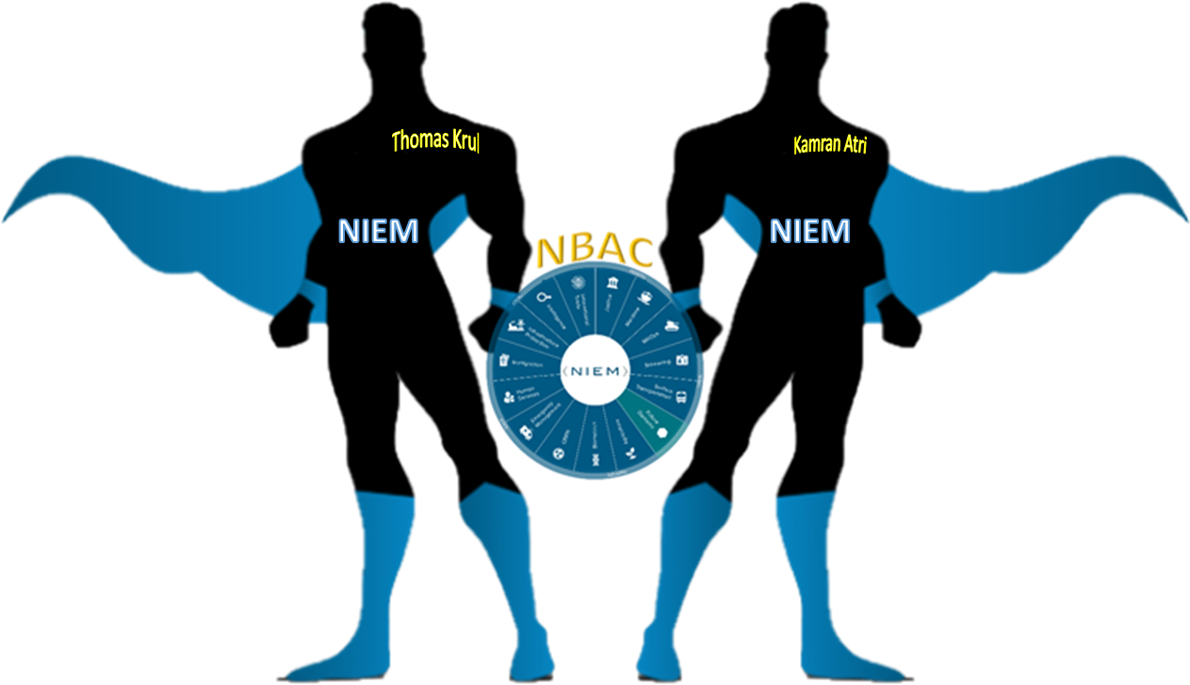
Enabling Connected Future Now
NBAC Co-Chairs
Thomas Krul
Kamran Atri
thomas.krul@canada.ca
katri@A4SAFE.COM
17

Slide 18
Annual Meeting Overview (14-18 September)
NBAC Session | Event Date/ Time | Topic | Primary Facilitator (s) | Support Facilitator (s) | Guest Speaker (s)
1 | Monday, 14 SEP 10 - 12 AM | Advance NIEM Adoption | Kamran Atri | Thomas Krul | Kshmendra Paul
2 | Monday, 14 SEP 1 - 3 PM | State, Local, Tribal Tiger Team | Cait Ryan / Tom Carlson | Thomas Krul | Eric Sweden (NASCIO)
3 | Tuesday, 15 SEP 10 - 12 AM | Support Domain Growth | Kamran Atri | Thomas Krul | Brian Gattoni (DHS CISA CTO)
4 | Tuesday, 15 SEP 1 - 3 PM | Emerging Technologies Tiger Team | Jalal Mapar | Lain McNeill | Syed Mohammed
5 | Wednesday, 16 SEP 10 - 12 AM | Improve NIEM Implementation | Thomas Krul | Kamran Atri | Dr. Paul Flynn (JNKE)
6 | Wednesday, 16 SEP 1- 3 PM | International Tiger Team | Thomas Krul | Kamran Atri | Poewan Lau
7 | Thursday, 17 SEP 10 - 12 AM | NIEM Release Planning | Christina Medlin | TBD | N/A - Working Session
8 | Thursday, 17 SEP 1- 3 PM | NBAC/NTAC Collaboration Planning | Kamran Atri/ Web Roberts | Thomas Krul/ Dr. Scott Renner | N/A - Working Session
9 | Friday, 18 SEP 10 - 12 AM | NIEM 2021 Priority Planning | Katherine Esobar | Stephen Sullivan | Stuart Whitehead
10 | Friday, 18 SEP 12 -12:15 PM | WRAP-UP/Adjourn | Kamran Atri / Thomas Krul | Stephen Sullivan | N/A

